Slide 1
Declaring Variables
Version: 05-Apr-2018

Slide 2

What is a Variable?
In a class of 30 students, the number of females is twice than the number of males.
How many males are there in the class?
Let “x” be the number of males.
Thus, 2x + x = 30
“x” can hold a
positive whole number

Slide 3
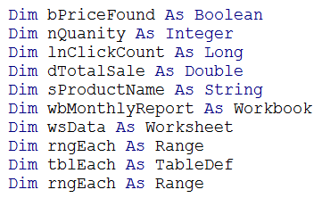
How to name VBA variables
Use Prefix indicative of data type
Notes:
Use Data Type Prefixes For Each VBA Variable

Slide 4
Variable Data Types:
Data Type | Bytes Used | Range of Values
Boolean |  | True or False
Integer |  | -32,768 to 32767
Long |  | -2,147,483,648 to 2,147,483,647
Single |  | -3.402823E38 to 1.401298E45
Double (negative) |  | -1.79769313486232E308 to -4.94065645841247E-324
Double (positive) |  | 4.94065645841247E-324 to 1.79769313486232E308
Currency |  | -922,337,203,685,477.5808 to 922,337,203,685,477.5807
Date |  | 1/1/100 to 12/31/9999
String | ● per character | Varies according to the number of characters
Object |  | Any defined object
Variant *** | Varies | Any data type
Used defined | Varies | Varies
*** If you omit the data type, VBA applies the Variant data type to your variable

